Slide 1
Smart Quote HP Automation Drive
Aug 30, 2017

Slide 2
HP Automation Drive? A Selenium WebDriver-based framework that slowly evolved into what we're introducing as HP Auto Drive.

Slide 3
What’s in HP Auto Driver? HP Automation Drive uses selenium WebDriver,Maven and TestNG underneath the hood.
How HP Auto Driver works and the philosophy behind it.
HP Auto Drive uses Page Objects as a base methodology, which is commonly recommended by the Selenium community. In essence, don't hard-code your page element identifiers in your test cases. Build them in a way that you can make one change in one location, and suddenly all your test cases change with it. HP auto driver does this by taking a Jason page definition file and turning it into a Java class you can refer to in your test cases. If your page element changes, the classes get regenerated. If you have multiple teams accessing the same classes, they don't have to change anything in their test case code. It has certainly worked for us at a large scale, and we don't have to re-write or maintain the base page classes.

Slide 4
Test In Scope / Out of Scope

Slide 5
SQ Regression Test In Scope
No. | Module | Test Cases | Type | Remarks
1 | Admin Function | 1. HPI_Internal_Admin__Reporting 2. HPI_Internal_Admin__Sales Notification 3. HPI_Internal_Admin_Country Email Config 4. HPI_Internal_Admin_Country Email Config_Event Validation 5. HPI_Internal_Admin_Distributor Submit on Behalf 6. HPI_Internal_Admin_Distributor-Reseller Mapping 7. HPI_Internal_Admin_Edit Config 8. HPI_Internal_Admin_Manage Corporate Resellers 9. HPI_Internal_Admin_Manage My Stand-Ins 10.HPI_Internal_Admin_Manage Users 11. HPI_Internal_Admin_Manage Workbuckets 12. HPI_Internal_Admin_Manage Workbuckets_Permission Validations 13. HPI_Internal_Admin_Partner User Change on any existing quote 14. HPI_Internal_Admin_Routing_Quote Lead 15. HPI_Internal_Admin_Routing_User Assignment 16. HPI_Internal_Admin_Set-up & Map Additional Flags 17. HPI_Internal_Admin_SR_PBM Email Config_SR 18. HPI_Internal_Admin_Translation Upload_Upload List Table 19. HPI_Internal_Admin_Translation Upload_Upload Translate Table 20. HPI_Internal_Admin_Translation Upload_View_Edit_Download List Table 21. HPI_Internal_Admin_Translation Upload_View_Edit_Download Translate Table 22. HPI_Internal_Admin_Upload HPI_Product Options 23. HPI_Internal_Admin_Upload HPI_Product Price Markup 24. HPI_Internal_Smart Quote Admin User Roles Constrained by Transacting Company 25. EIS_EclipseTracker_DownLoadInExcelFormat 26. EIS_EclipseTracker_Search | Regression | In Progress

Slide 6
SQ Regression Test In Scope
No. | Module | Test Cases | Type | Remarks
2 | Copy Quote | 1. HPI_External_Copy Quote 2. HPI_Internal_Copy Quote | Regression | In Progre
3 | Create Quote | 1. HPI_CreateQuote_Verify Reseller User Guide – Not completed 2. HPI_CreateQuote_StartfromPFP_HP Logo and Footer and T&Cs 3. HPI_Distributor_CreateQuote_StartFromPFP 4. HPI_Distributor_Quote Outputs_Generated Quoted Document 5. HPI_External_Customer Affiliates 6. HPI_External_Customer Search_MDCP 7. HPI_External_Distributor tab_Distributor functionality 8. HPI_External_New Customer 9. HPI_External_Product tab_Import Product&Configuration 10. HPI_External_Product tab_IPG Selection 11. HPI_External_Product tab_Product Search 12. HPI_External_Product tab_Product&Configuration Attachment – Not completed 13. HPI_External_Quote Core Data tab_AdditionalFlag 14. HPI_External_Quote Core Data tab_Competitor list – N/A 15. HPI_External_Quote Core Data tab_Questionnaires 16. HPI_External_Reseller tab- Change Partner functionality – N/A 17. HPI_Reseller_Quote Outputs_Generated Quoted Document – Not completed 18. HPI External Reseller quote submission. | Regression | Completed
4 | E2E | 1. HPI_Reseller_Internal_PQ_End to End_High Touch Low Risk_Eclipse version 0 2. HPI_Distributor_Internal_PQ_End to End_High Touch High Risk 3. HPI_Distributor_Internal_PQ_End to End_Low Touch Low Risk 4. HPI_Reseller_Internal_PQ_End to End_Low Touch High Risk 5. HPI_Internal_PQ_End to End_High Touch High Risk 6. HPI_Internal_PQ_End to End_High Touch Low Risk_Eclipse version 0 7.Email Notification scenarios in Internal & external 8.Interlock asset case validation 9. Eclipse auto deal settings validation 10. DB validation 11.Job Validation | Regression | 1- 2 -7 completed 8-9-10-11 N/A

Slide 7
SQ Regression Test In Scope
No. | Module | Test Cases | Type | Remarks
5 | EIS | 1. HPI_Eclipse_DC Company Specific 2. HPI_Eclipse_DL or SR or DM Company Specific 3. HPI_Internal_EIS_ Displays Data 4. HPI_Internal_EIS_Bg or BU Info Send to Eclipse for Deal Creation 5. HPI_Internal_EIS_Change Partner functionality_Reseller Tab 6. HPI_Internal_EIS_Header Section 7. HPI_Internal_EIS_Manual Override Error Message Functionality – Not complted 8. HPI_Internal_EIS_Manual Override functionality – Not completed 9. HPI_Internal_EIS_Request Information, Indicators, Customer Information Functionality 10. HPI_Internal_EIS_Users Functionality | Regression | In Progress
6 | Mark Won | 1. HPI_External_Mark Won | Regression | In Progress
7 | Process Quote | 1. HPI_Internal_EIS_Distributor Tab_Change Partner functionality 2. HPI_Internal_Process Quote_Action Tab_Deal Lost functionality 3. HPI_Internal_Process Quote_Action Tab_Deal Won functionality 4. HPI_Internal_Process Quote_Action Tab_Reject Request functionality 5. HPI_Internal_Process Quote_Action Tab_Request Qualified functionality 6. HPI_Internal_Process Quote_Add Products Attachments 7. HPI_Internal_Process Quote_Add Products Functionality 8. HPI_Internal_Process Quote_Change Partner functionality 9. HPI_Internal_Process Quote_Import Excel or SBW XML Configuration File 10. HPI_Internal_Process Quote_Match Customer functionality 11. HPI_Internal_Process Quote_Route to Sales Rep 12. HPI_Internal_Process Quote_Search Products functionality | Regression | Completed
8 | Resubmit Quote | 1. HPI_External_ReSubmit Quote | Regression | In Progress

Slide 8
SQ Regression Test In Scope
No. | Module | Test Cases | Type | Remarks
9 | Search Functions | 1. HPI_External_AdvancedSearch_withPPA 2. HPI_External_AdvancedSearch_withPPU 3. HPI_External_MyActiveQuotesSearch_withPPA 4. HPI_External_MyActiveQuotesSearch_withPPU 5. HPI_External_SearchQuote_withPPA 6. HPI_External_SearchQuote_withPPU 7. HPI_External_ViewQuote_withPPA 8. HPI_External_ViewQuote_withPPU 9. HPI_Internal_Process Quote_Advance Search functionality 10. HPI_Internal_User Access Quotes | Regression | In Progress
10 | APJ Quoting improvements R1 - Auto OPG Creation, EOS Check and UI Simplification | 1. Auto OPG Release High Risk multiple deals scenario All countries with all MC Codes 2. Auto OPG Release High Risk single deal scenario AU and NZ ONLY 3. Auto OPG Release High Risk single deal scenario with MC Code 72G All countries EXCEPT AU and NZ 4. Auto OPG Release High Risk single deal scenario with MC Code NOT belongs to 72G All countries EXCEPT AU and NZ 5. Auto OPG Release Low Risk multiple deals split deals scenario All countries 6. Auto OPG Release Low Risk single deal scenario All countries 7. SQ_Channel_Q4FY16_EOS 8. SQ_Channel_Q4FY16_Simplify User Interface Screen | Regression | In Progress
11 | APJ Quoting improvements R2 - Auto Deal Qualification | 1. Auto Quote Qualification & Deal Creation - Add and Import Product 2. Auto Quote Qualification & Deal Creation - Deal Reg - Threshold check AU 3. Auto Quote Qualification and Deal Creation - New Customer 4. Auto Quote Qualification and Deal Creation - CMPS checks 5. Auto Quote Qualification and Deal Creation - Deal Reg ID Acct Type and flag similar dea 6. Auto Quote Qualification and Deal Creation - Distributor Eligibility Check 7. Auto Quote Qualification and Deal Creation - TBM checks India 8. Auto Quote Qualification and Deal Creation - TBM checks Non-India countries 9. R1 Auto OPG Release - High Risk Non-72G deal for all countries except AU and NZ 10. Auto Eclipse Deal Creation_Account Type | Regression | In Progress

Slide 9
Test Scenarios

Slide 10
Test Scenarios
Total Test Scenarios | Team | # Total TC | #Complted Tcs | In Progress
External & Internal | QA | 108 | 39 | 69
Total |  | 108 | 39 | 69

Slide 11
Test Drive

Slide 12
ITG URLs and Test Accounts
Description | ITG URLs
ITG PFP login page URL | https://partner-itg.hp.com/
ITG Standalone Application | Internal : External :

Slide 13
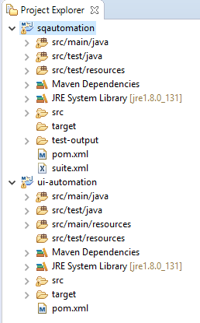
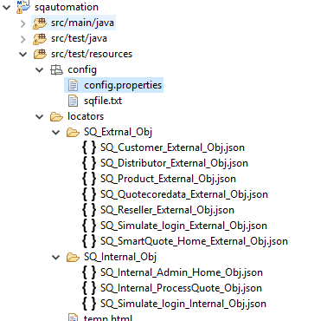
Project Flow

Slide 14
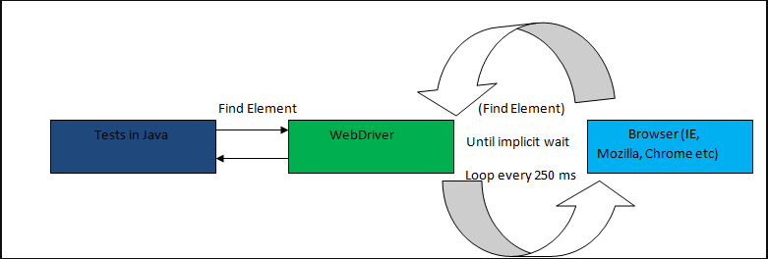
Drive flow chat

Slide 15
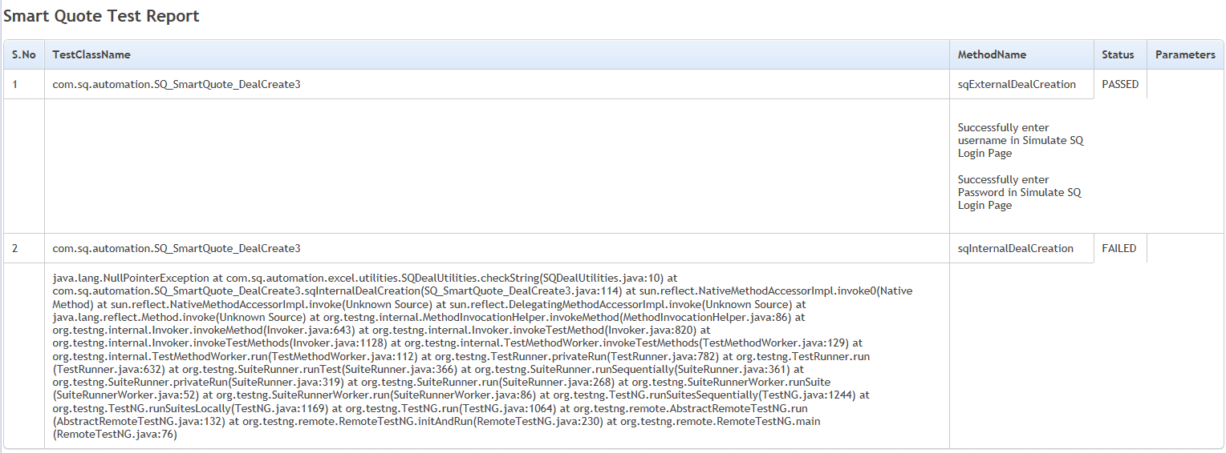
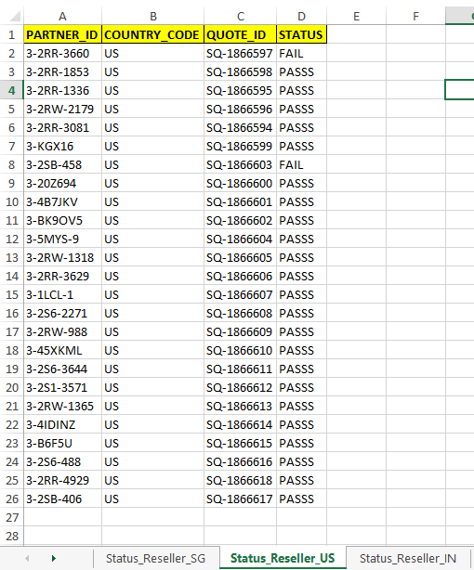
Regression test execution status

Slide 16
Thank you

